Slide 1
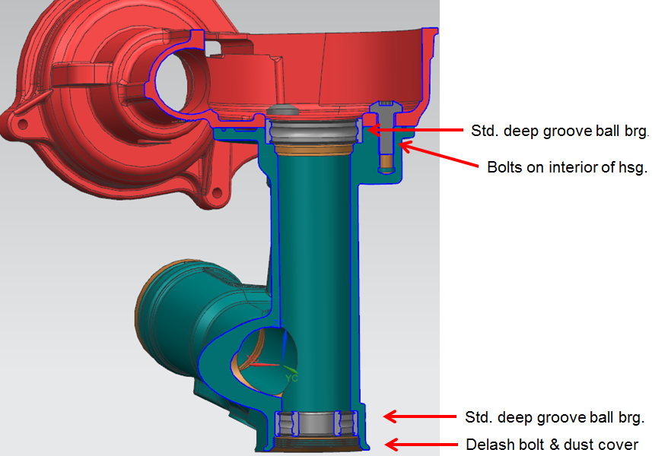
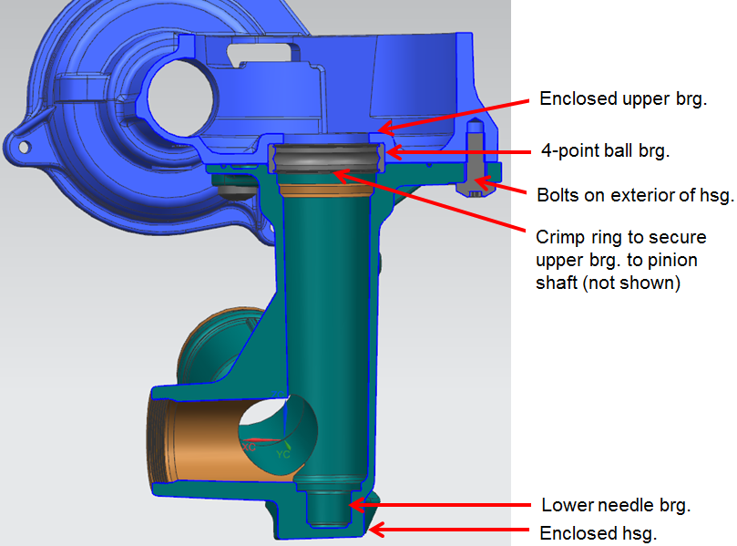
CCM-109: Non-delashed Pinion
Last updated: 23FE16
Description
Develop Non-delash design for BMW SPEPS
Motivation : XX
Deliverables
Acceptable pinion axial lash
Acceptable NVH performance
Backdrive performance
Timing
Print changes for rack and assist mech. housings (1-2 weeks)
Ordering components (4-6 weeks)
NVH evaluations (1-2 weeks)
Pre & Post pinion axial lash check (1 week)
Team Members/Customers
Team names: Jason Kandal
Customers: BMW (PSA currently in DV stage with similar design)
Current Design
Non-Delash Design

Slide 2
CCM-109: Non-delashed pinion
Last updated: 23FE16
Status Update:
FEA Complete
Results showed acceptable levels of stress in housings at LMC & MMC
Print Changes
New machined from solid parts to be ordered as soon as print changes are complete (Rack & Assist Mech. Hsg)
Challenges:
Supplier timing
CAD support for print changes if necessary
Part/vehicle availability for NVH
Next Actions:
Order components

